Slide 1
Theories of the Formation of the Universe

Slide 3
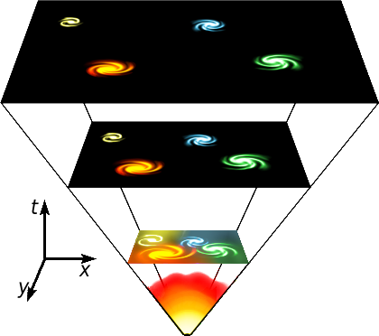
The Big Bang Theory
The Universe came into existence around 14 billion years ago from the expansion of a single infinitely-dense and hot point called a “singularity.”

Slide 4
The Big Bang Theory
In a fraction of a second, it expanded outward, beginning the creation of all galaxies, stars, and matter that now makes up our Universe.

Slide 5
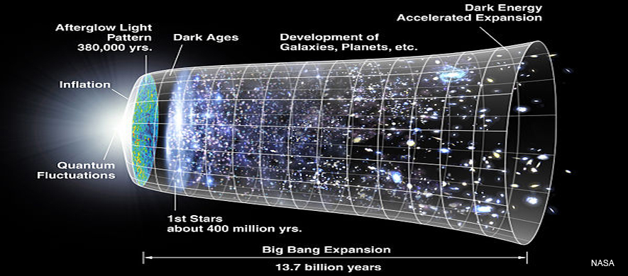
The Big Bang Theory
The Universe has been expanding and cooling ever since.

Slide 6
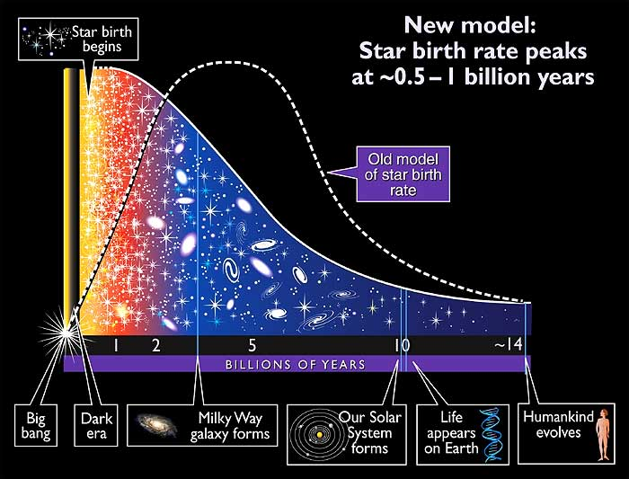

Slide 7
Who’s Idea Was It?
Originally proposed by Georges Lemaitre in 1926.
BUT –
Credit for the Big Bang Theory is given to Edwin Hubble.
He used the DOPPLER EFFECT to prove the theory…

Slide 8
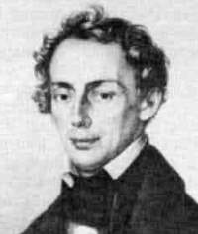
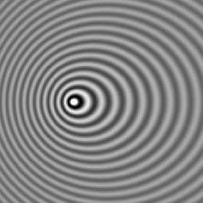
The Doppler Effect
http://youtu.be/Kg9F5pN5tlI
A change in the Wavelength and Frequency of the wave of a moving object, as observed by a stationary observer.
The Doppler Effect applies to:
Sound Waves & Light Waves
Christian Doppler, 1842
Austrian mathematician and physicist.

Slide 9
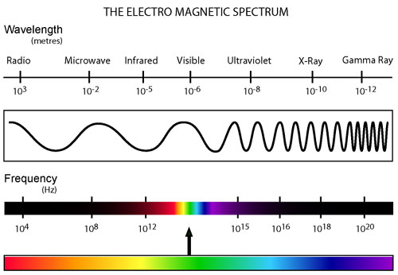
Let’s Back Up for a Minute…

Slide 10
Light or Sound Waves of a Stationary Object:

Slide 11
Light or Sound Waves of a Moving Object:

Slide 12
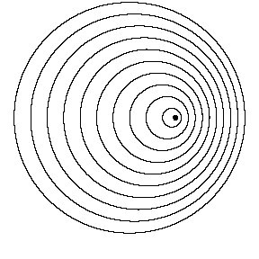
Let’s Talk About It…

Slide 13
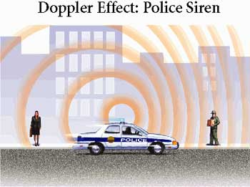

Slide 14
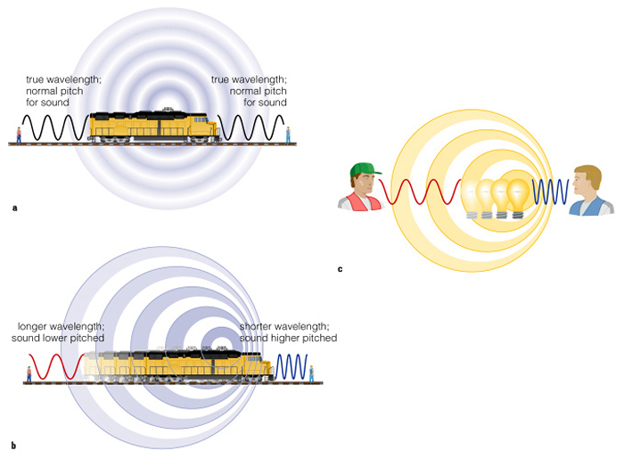

Slide 15
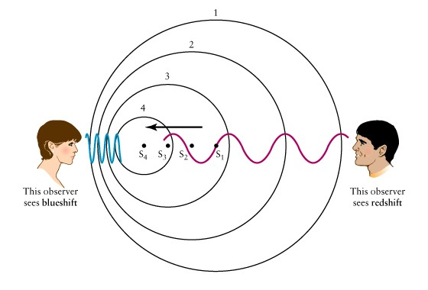

Slide 16
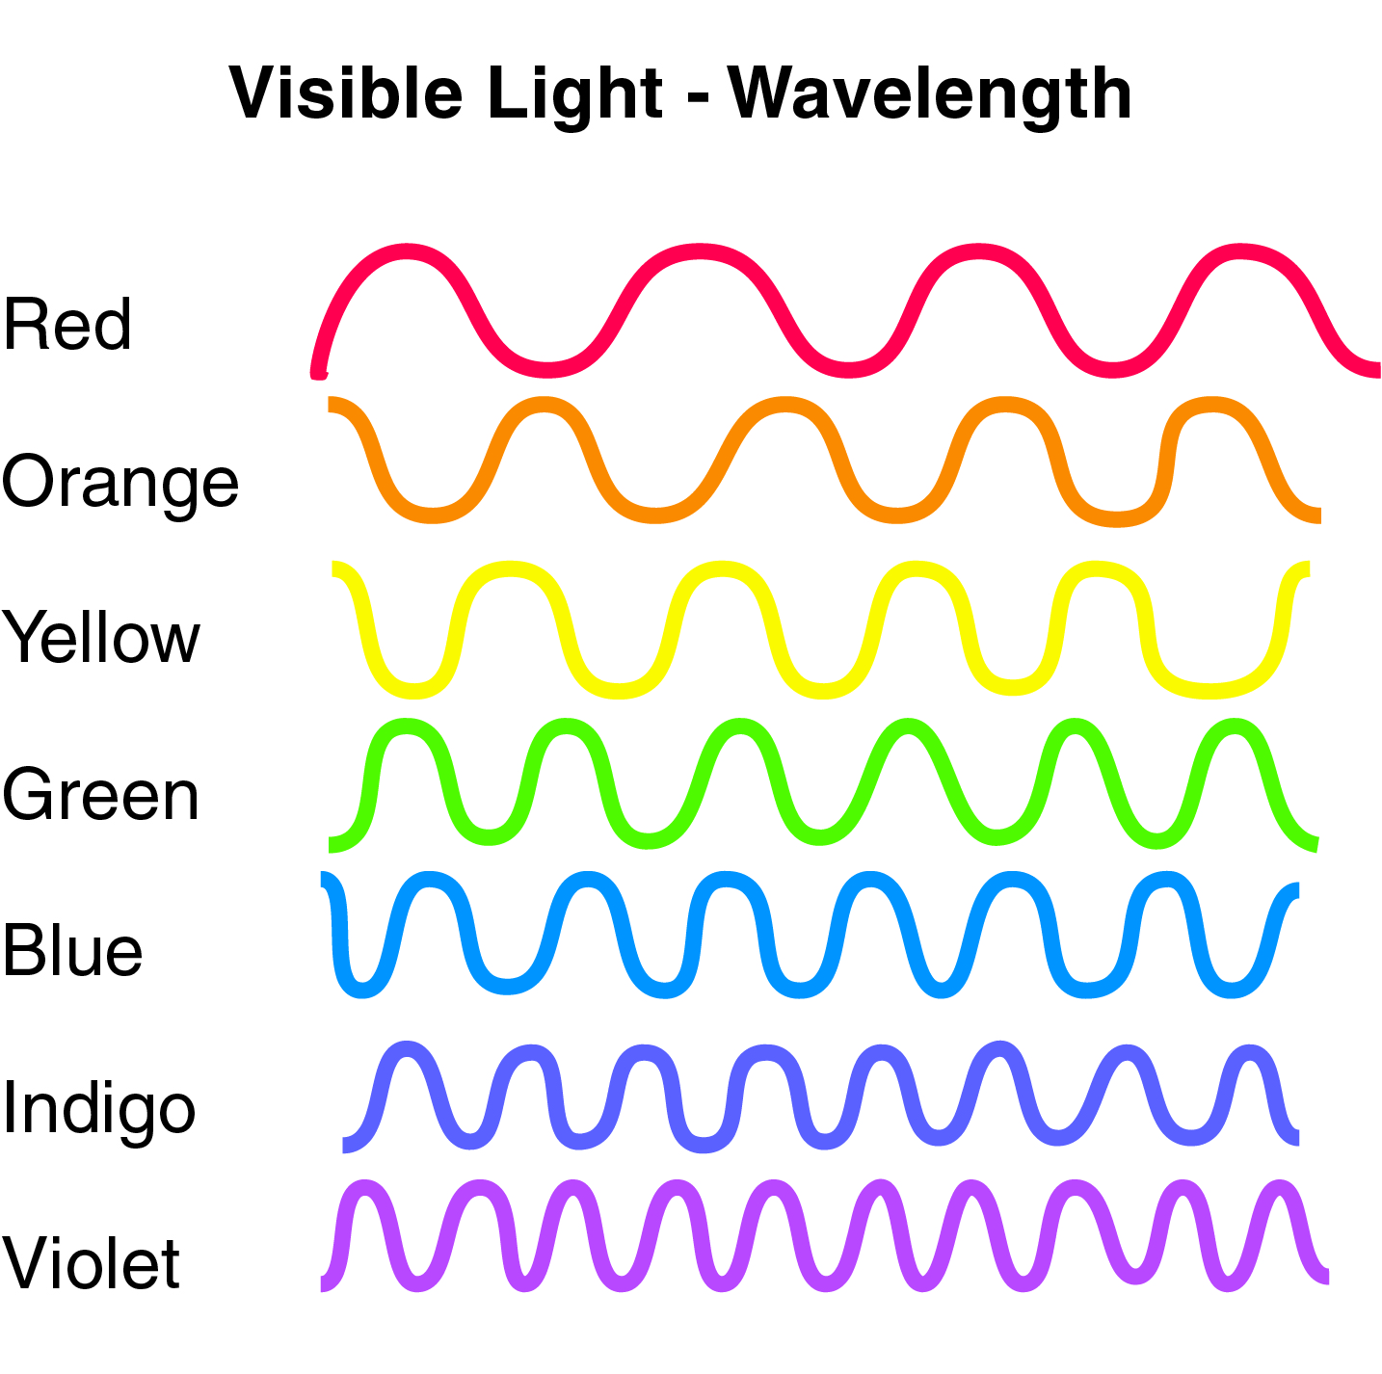
Red Light:
Long Wavelength
Low Frequency
Low Energy
Blue/Violet Light:
Short Wavelength
High Frequency
High Energy

Slide 17
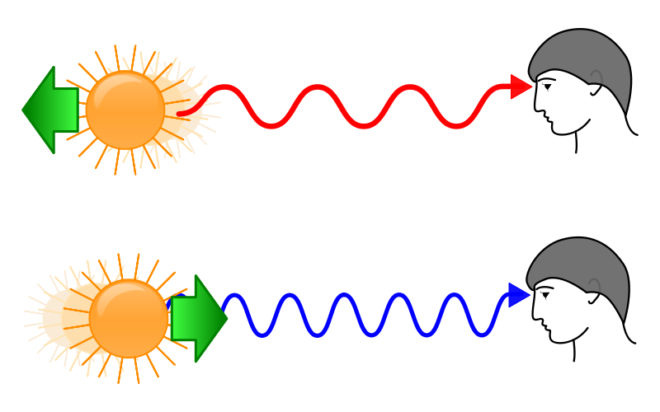

Slide 18
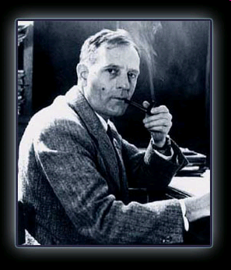
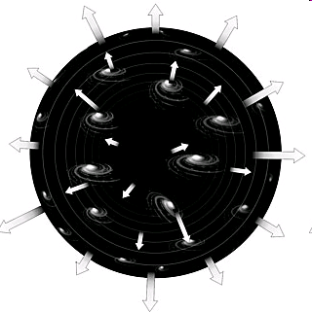
The Big Bang Theory
The Universe is expanding!
-Edwin Hubble, 1929

Slide 19
Other Theories?

Slide 20
Oscillating Theory Alexander Friedman - 1922
Universe has gone through periods of expansion and contraction.
After the Big Bang, the Universe expands for a while before the gravitational attraction of matter causes it to collapse back in on itself.
“Big Bang” then “Big Crunch”
The Universe is currently in a period of expansion.

Slide 21
Steady-State Theory Fred Hoyle - 1940
The Universe is not expanding.
Galaxies are not moving away from each other.
“The Universe is now as it has always been.”

Slide 22
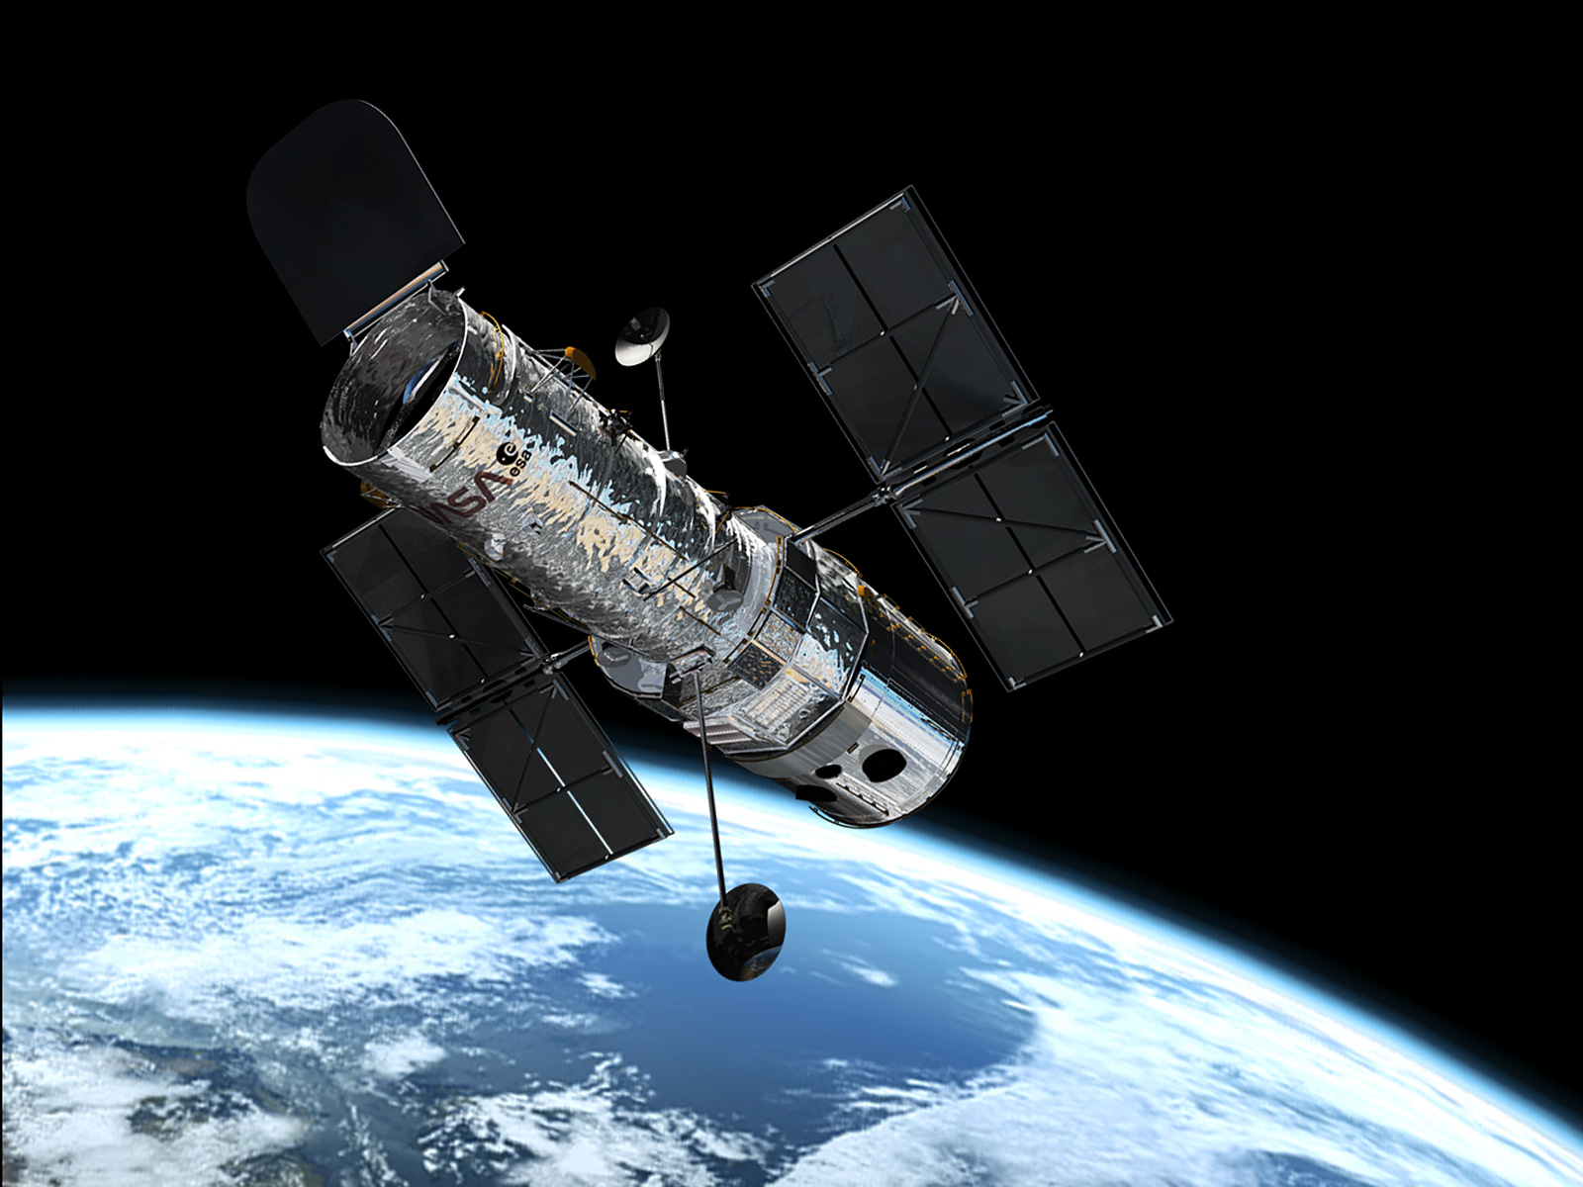
Hubble Telescope

Slide 23
Hubble Telescope
Launched 1990
43.5 ft. long; 14 ft. diameter; 24,500 lbs.
Speed: 17,500 mph
Altitude: 353 mi.
Time to complete one orbit: 97 mins.
Can Observe: Infrared, Visible, and Ultraviolet Light

Slide 24
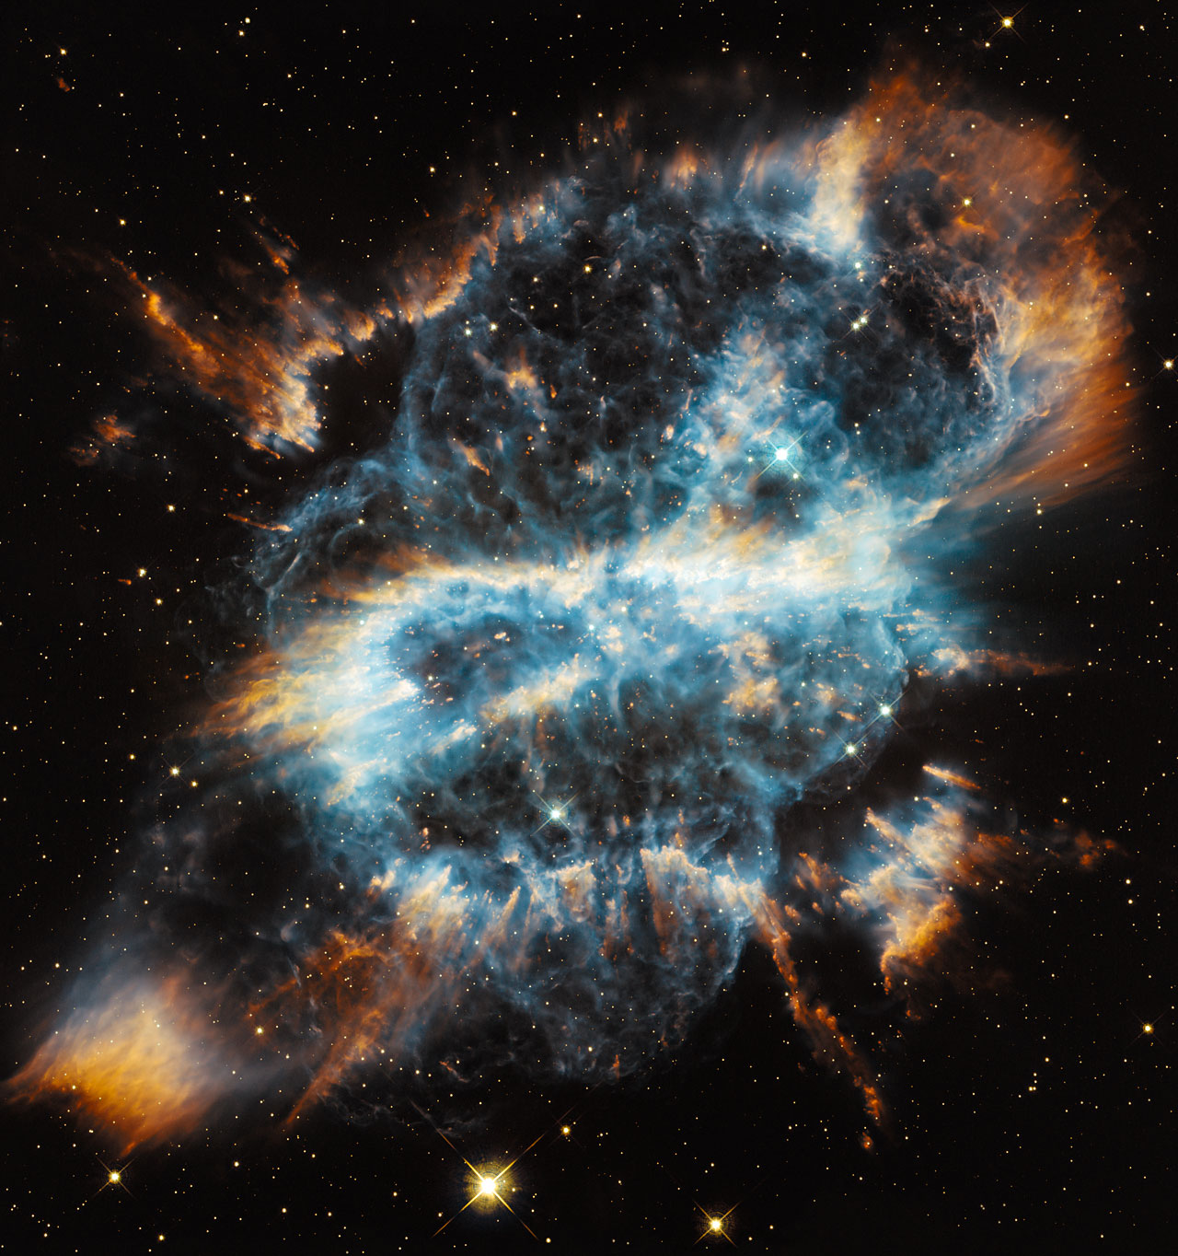

Slide 26
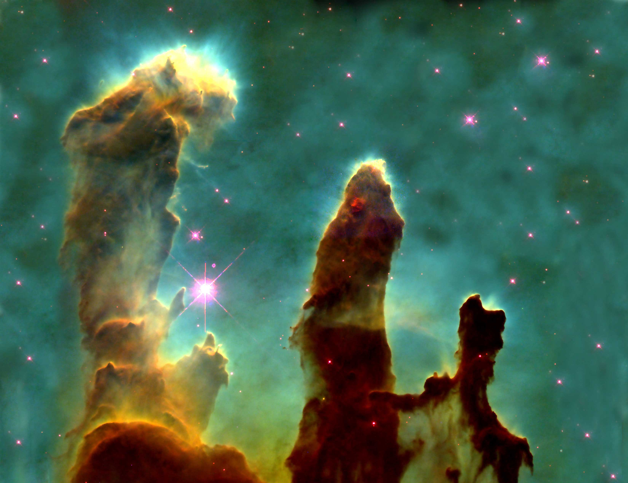

Slide 27
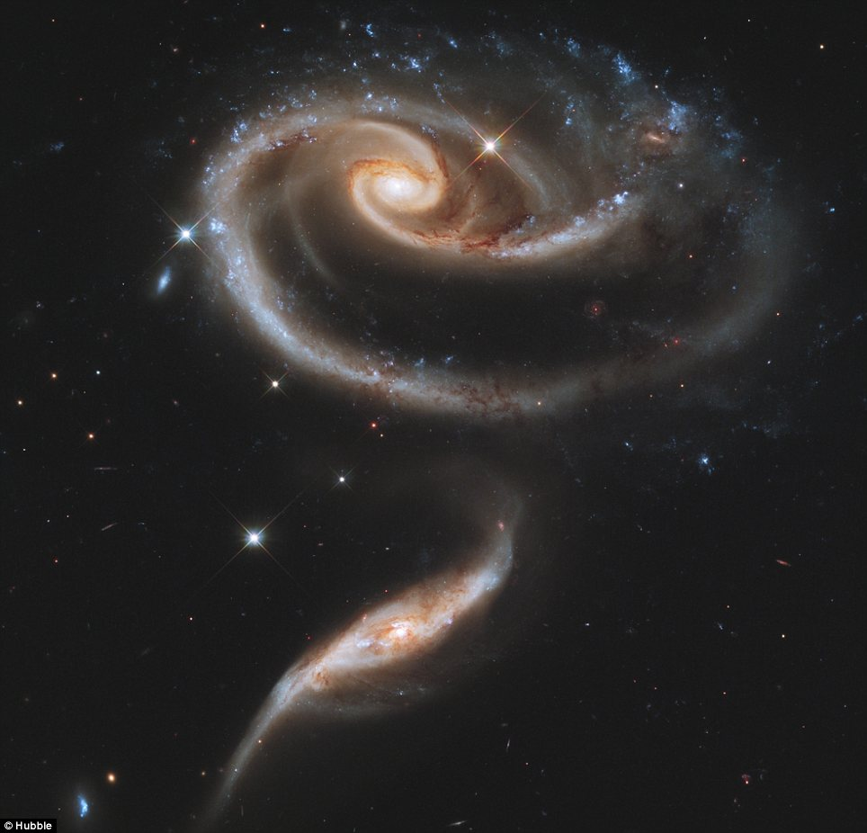

Slide 28
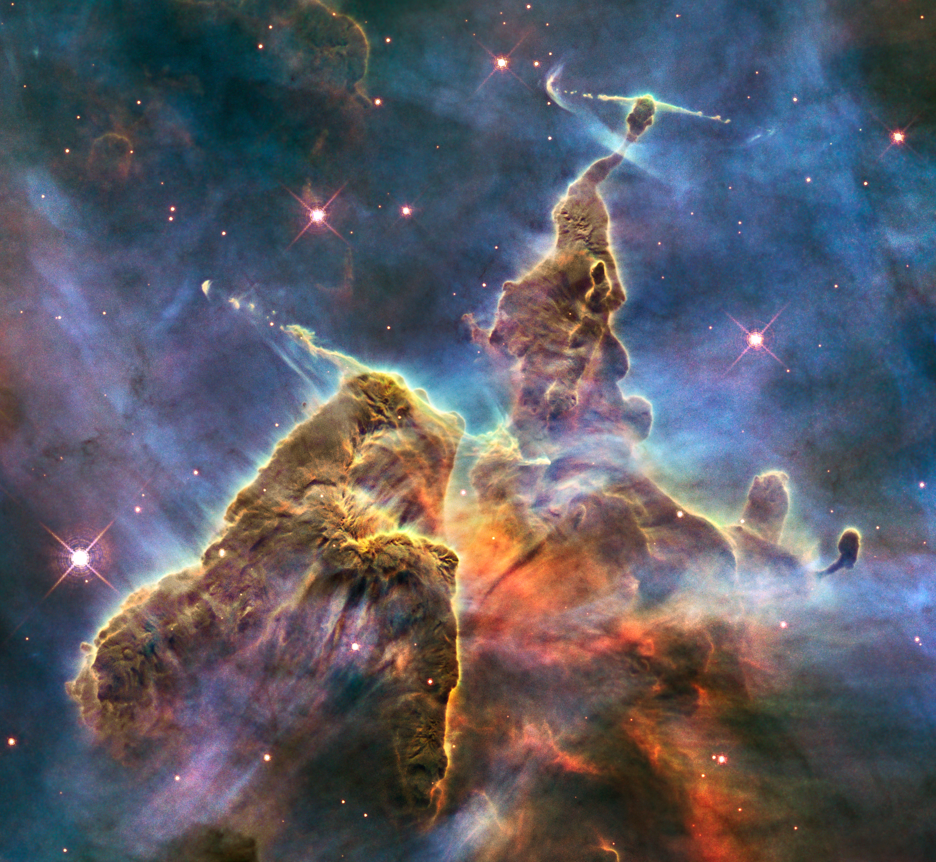

Slide 29
Then they kicked it up a notch…
Hubble eXtreme Deep Field Project (2012)
Looking back 13.2 billion years…

Slide 30
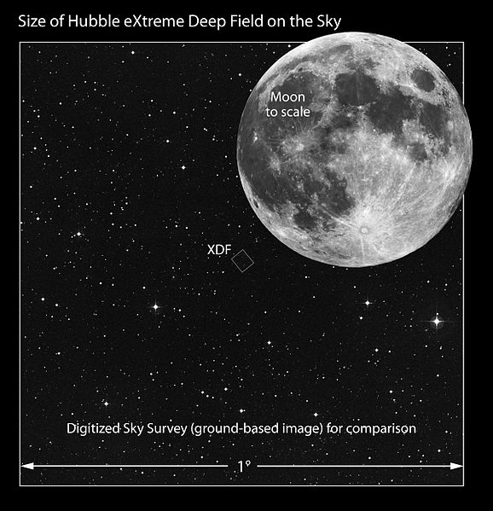

Slide 31
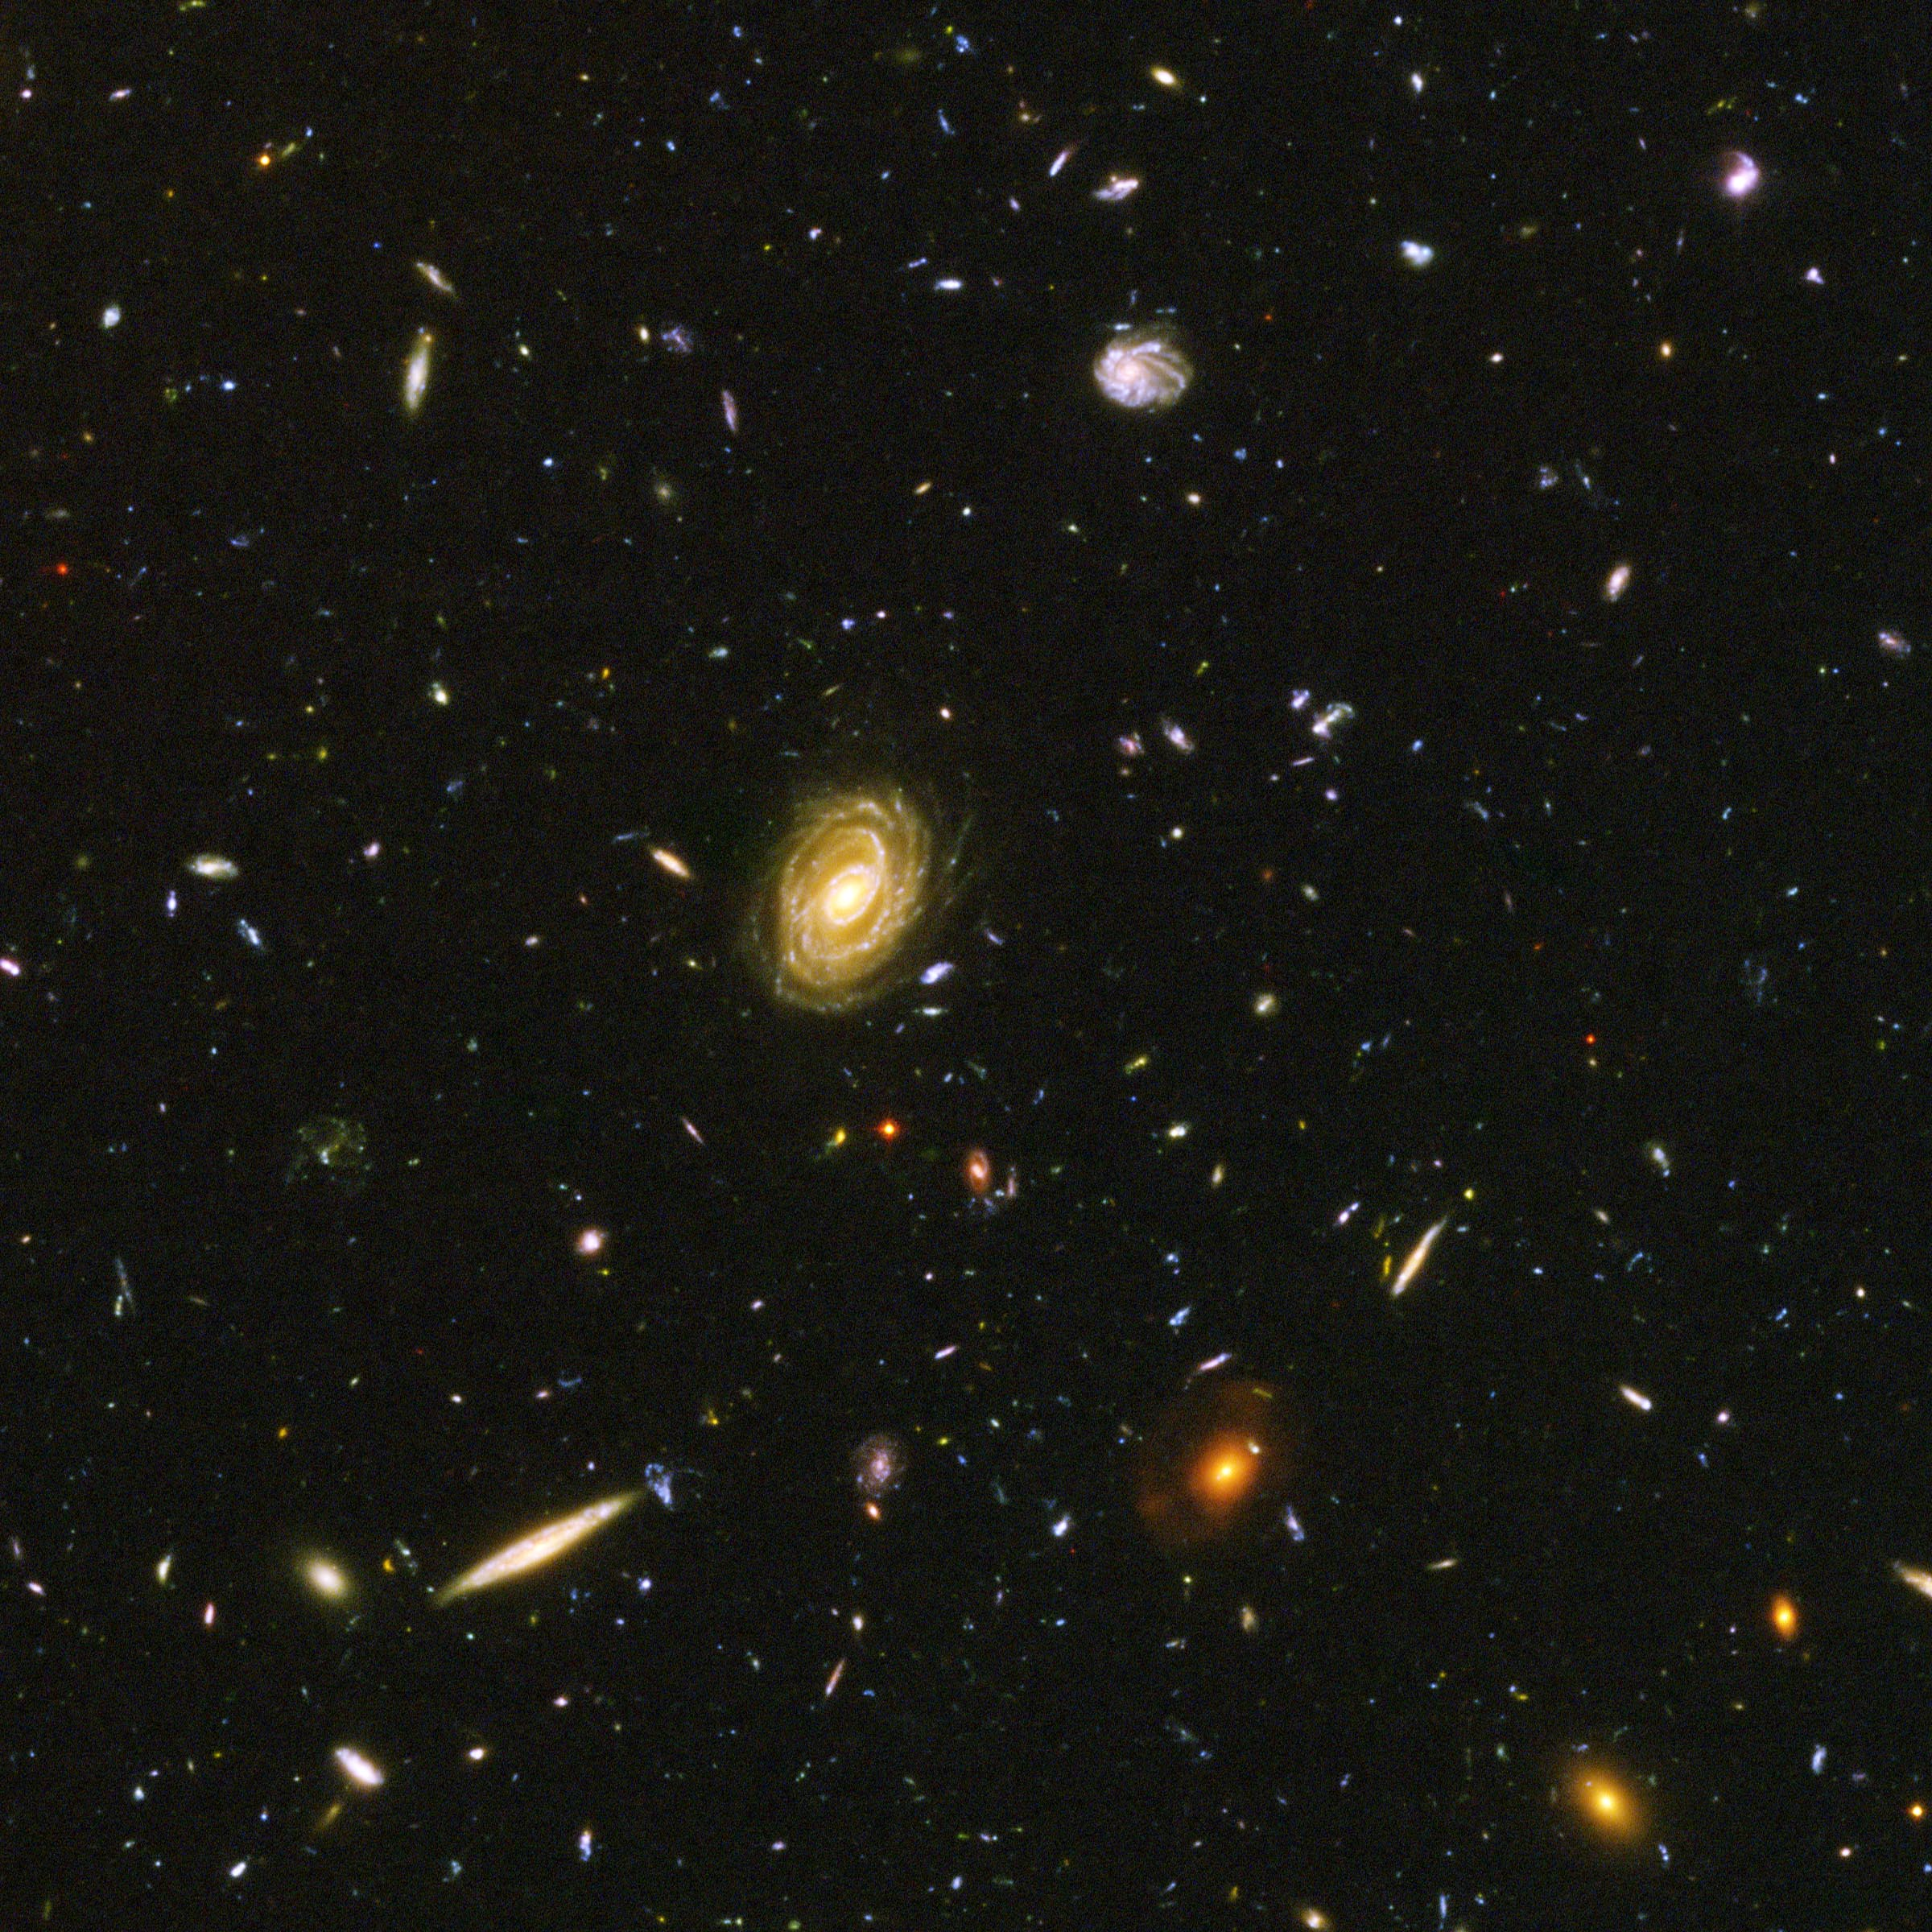

Slide 32
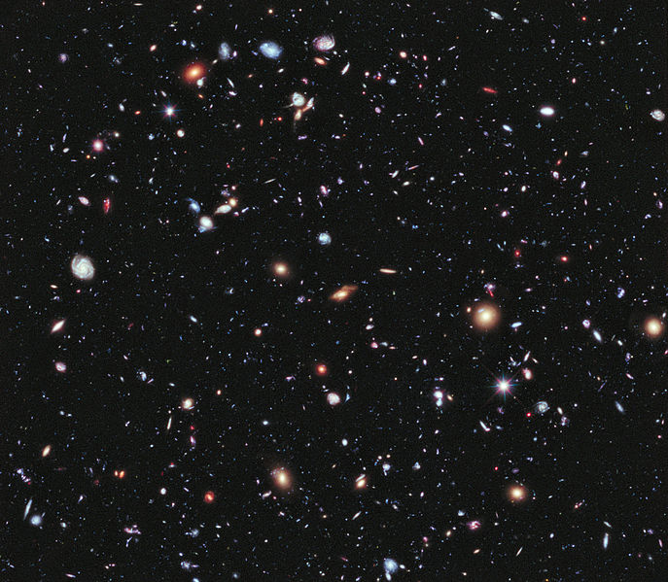

Slide 33
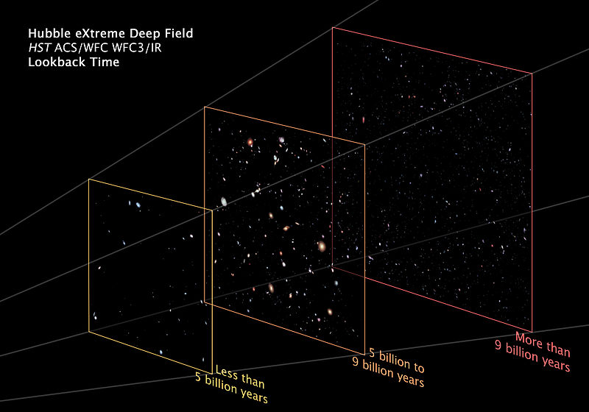

Slide 34
Show Me What You Know:
Big Bang Theory
Oscillating
Theory
Steady State
Theory

Slide 36
Light or Sound Waves of a Moving Object:

Slide 37
Light or Sound Waves of an Object Moving at Mach 1 (speed of sound):

Slide 38
Light or Sound Waves of an Object Moving at Mach 1.4 (supersonic):

