Slide 1
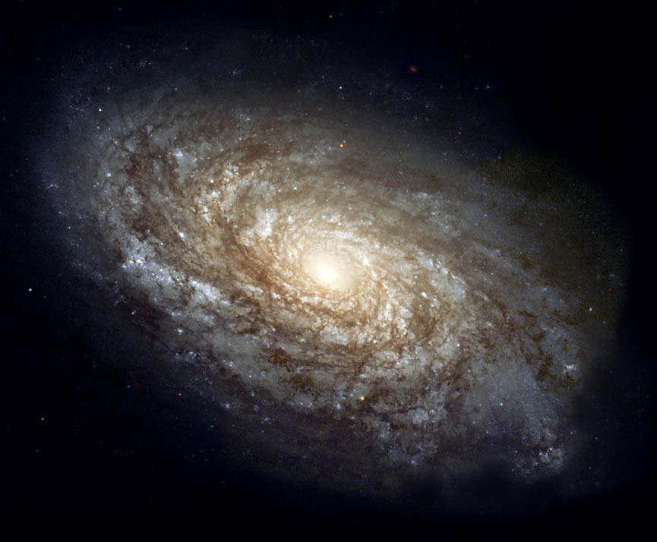
Galaxies…

Slide 2
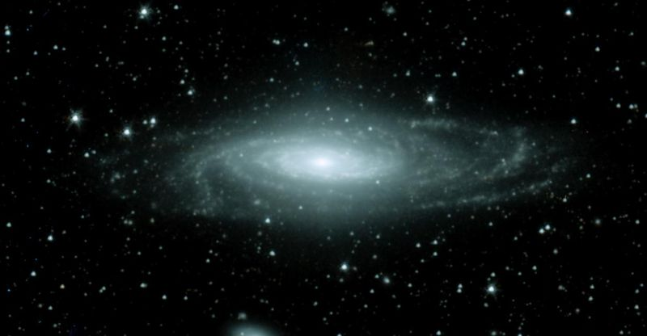
Galaxies…
Group of stars, dust, and gas held together by gravity
We live in the Milky Way Galaxy

Slide 3
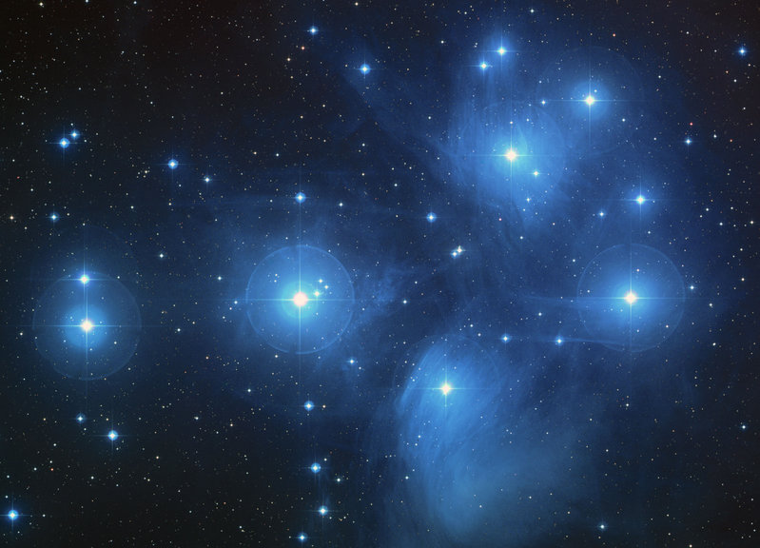
Galaxies can be found in large groups called clusters

Slide 4
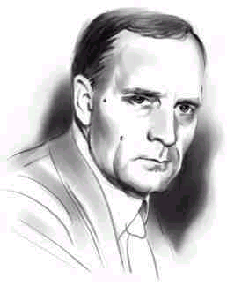
Dr. Edwin Hubble
Made some of the most important discoveries in astronomy
Evidence to support Big Bang
Classification system for galaxies
Edwin Hubble
1889-1953

Slide 5
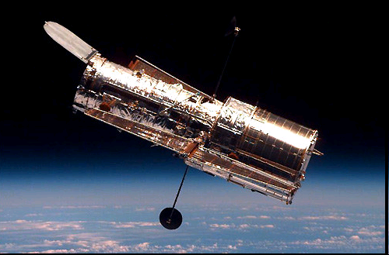
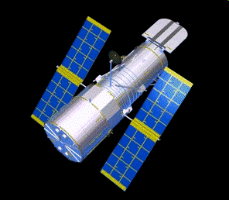
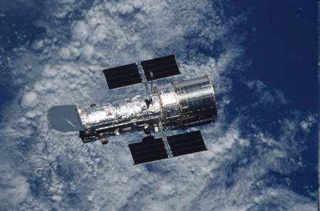
Hubble Telescope
(honoring Edwin Hubble!)

Slide 7
Galaxies are classified, in part, by their shapes.

Slide 9
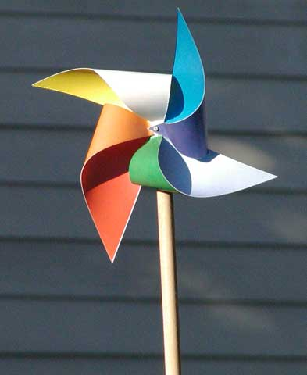
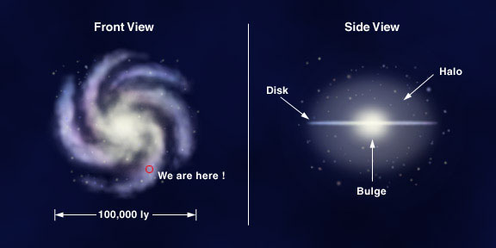
Spiral Galaxies
Looks like a pinwheel
Middle-aged galaxies
Milky Way is a
spiral galaxy

Slide 10
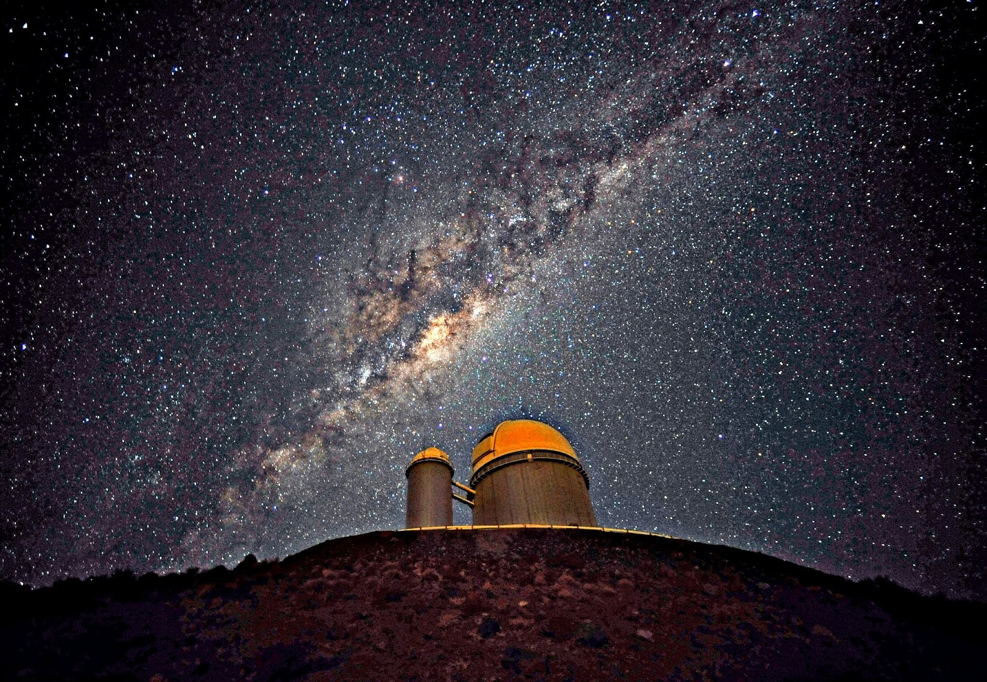

Slide 11
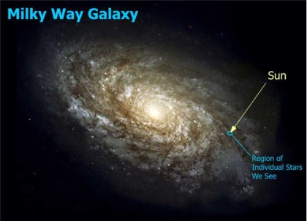

Slide 12
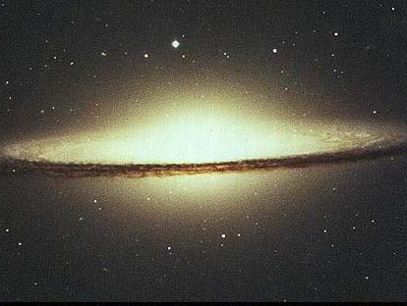
Sombrero Galaxy: Spiral

Slide 13
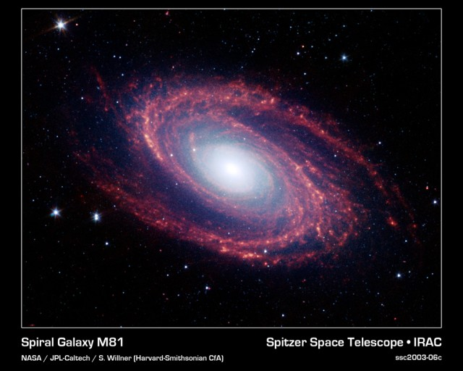

Slide 14
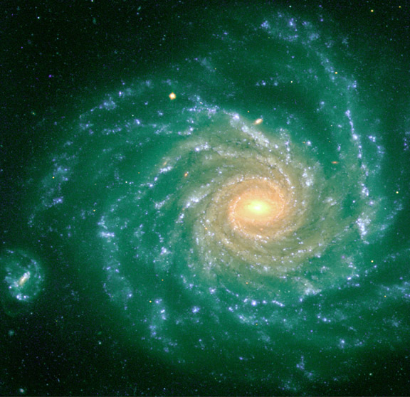

Slide 15
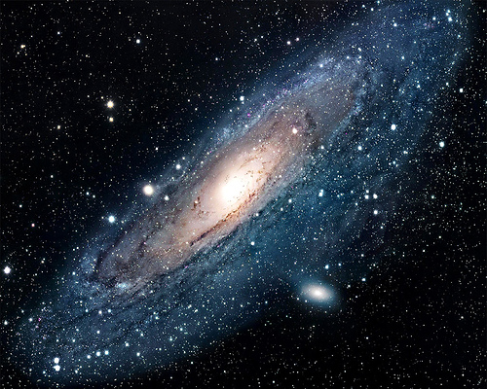
2.2 million light-years away in the constellation Andromeda. It is the nearest spiral galaxy to our own, the Milky Way, and is visible as a faint smudge on a moonless night to the naked eye.
The Andromeda Galaxy, M31

Slide 16
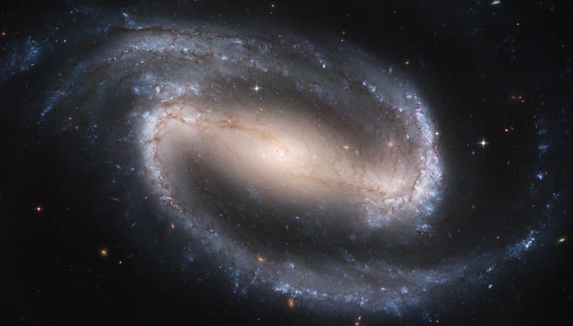
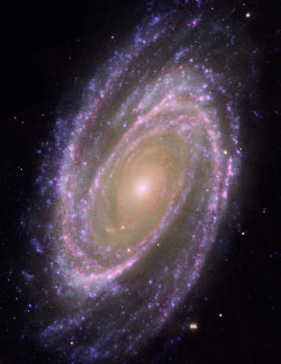
SPIRAL GALAXIES!

Slide 17
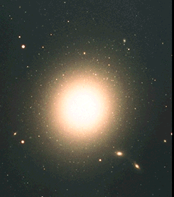
Elliptical Galaxy
Looks like a flattened ball
Has lots of stars
Little dust and gas
Most common galaxy type
Oldest galaxies (these
contain the oldest stars)

Slide 18
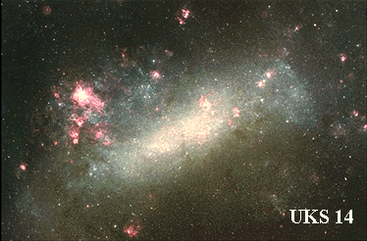
Irregular Galaxy
Rarest
Anything that is not elliptical or spiral falls into the category
Newest galaxies
(these contain the
youngest stars)

Slide 19
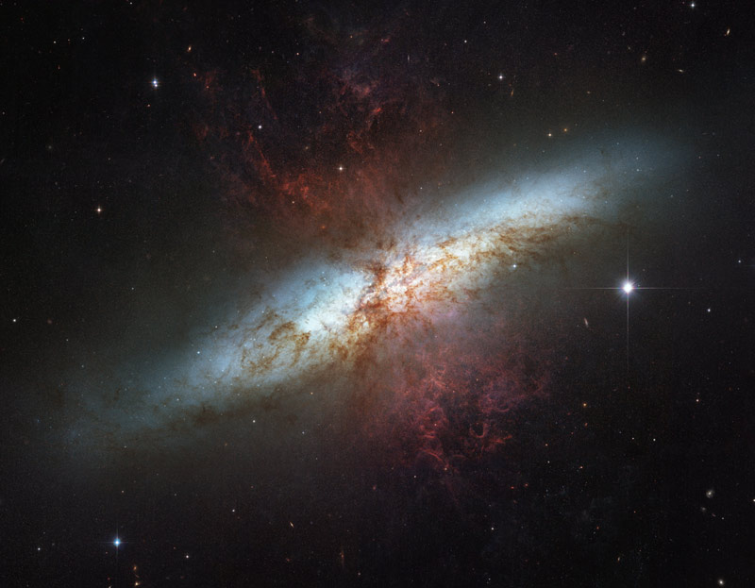
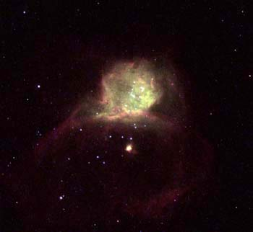
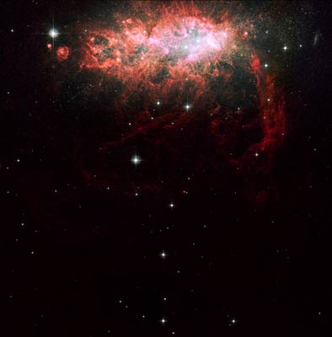
Irregular Galaxies

